Slide 1
Getting started with SharePoint Framework
Setup Office 365 tenant

Slide 2
Agenda
Configurations to Office 365 tenant
Verifying configuration
Q&A

Slide 3
Configurations to Office 365 tenant

Slide 4
Office 365 Developer Tenant Setup Steps
Sign up for an Office 365 Developer Tenant
Create app catalog site
Create a new Developer Site collection
SharePoint Workbench
http://dev.office.com/sharepoint/docs/spfx/set-up-your-developer-tenant

Slide 5
Sign up for an Office 365 Developer Tenant
Sign up for the Office Developer Program.
You will receive a welcome mail with a link to sign up for an Office 365 Developer Tenant.
Notes:
To build and deploy client-side web parts using the the SharePoint Framework, you will need an Office 365 Tenant.

Slide 6
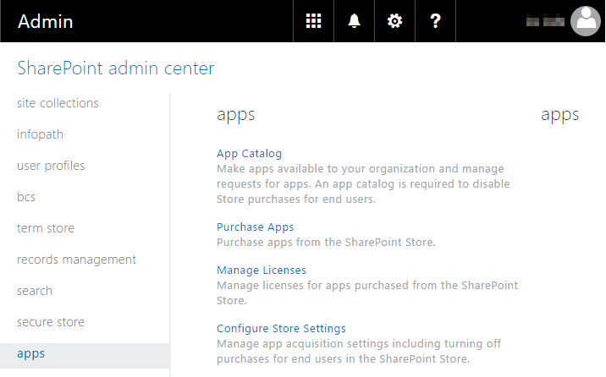
Create app catalog site
https://yourtenantprefix-admin.sharepoint.com

Slide 7
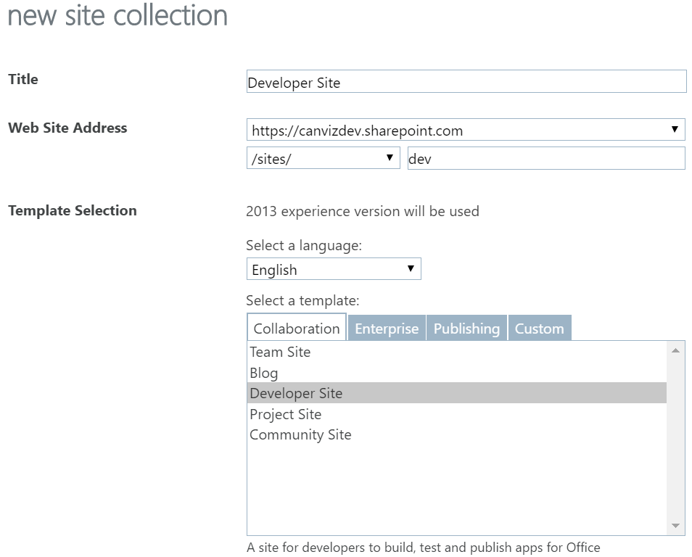
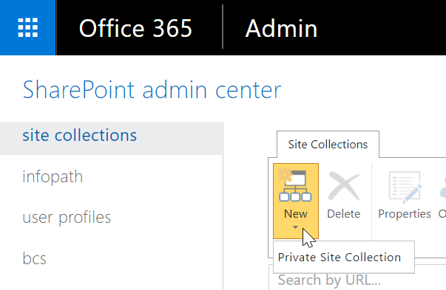
Create a new Developer Site collection
https://yourtenantprefix-admin.sharepoint.com

Slide 8
SharePoint workbench
You can access the SharePoint Workbench from any SharePoint site in your tenancy by browsing to the following URL:
https://your-sharepoint-site/_layouts/workbench.aspx

Slide 9
DEMO
Configuring Your Office 365 Environment

Slide 10
Verifying configuration

Slide 11
Verify It All Works
Install Hello World Client-side web part and test

Slide 12
DEMO
Verifying Configuration

Slide 13
Summary
Configurations to Office 365 tenant
Verifying configuration
Q&A

Slide 14

Sharing is caring…
Code samples and solutions
Reusable components
Guidance documentation
Monthly community calls
SharePoint Framework
SharePoint add-ins
Microsoft Graph
Office 365 APIs
http://aka.ms/SharePointPnP

Slide 15

Q&A

Slide 16


